Slide 1

Thursday 13th November

Slide 2
Workshop aims:
What is Kinetic Letters?
How to help at home

Slide 3
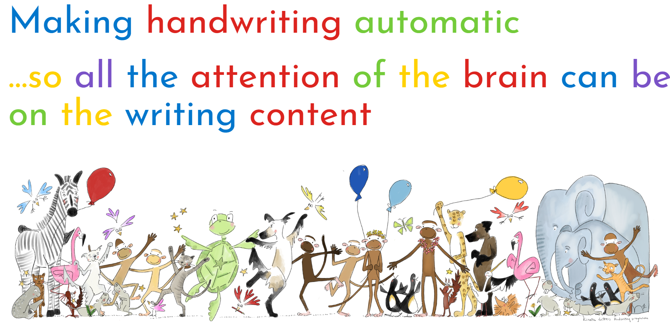

Slide 4
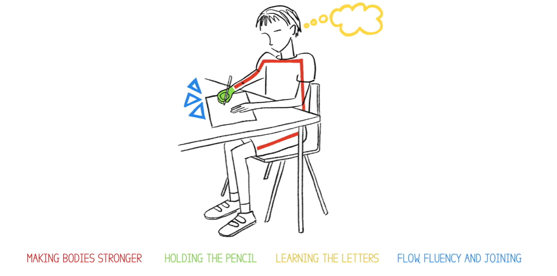

Slide 5
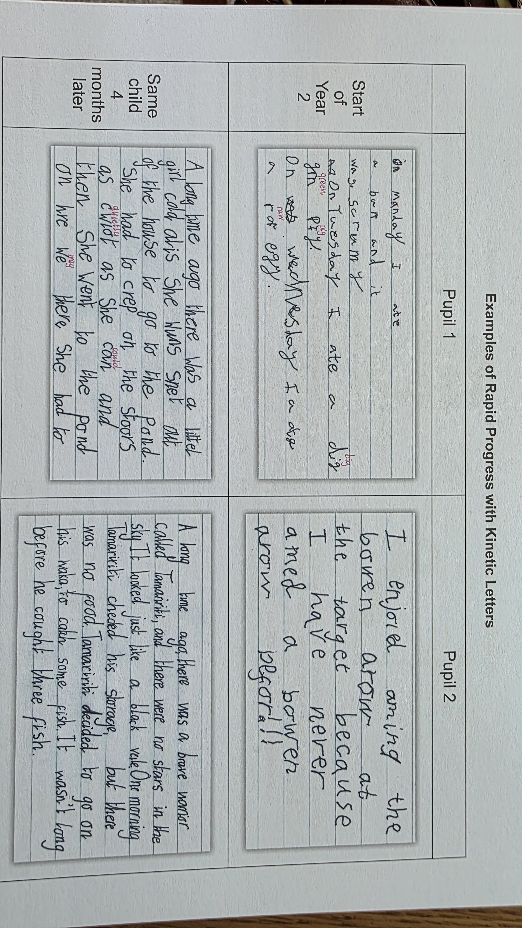

Slide 6

Red Thread: Making Bodies Stronger

Slide 7
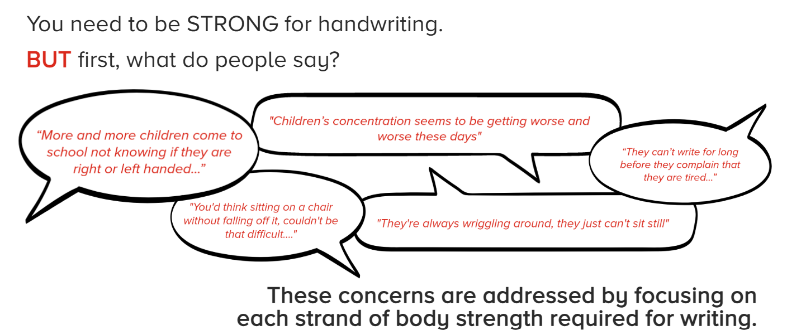
Making Bodies Strong

Slide 8
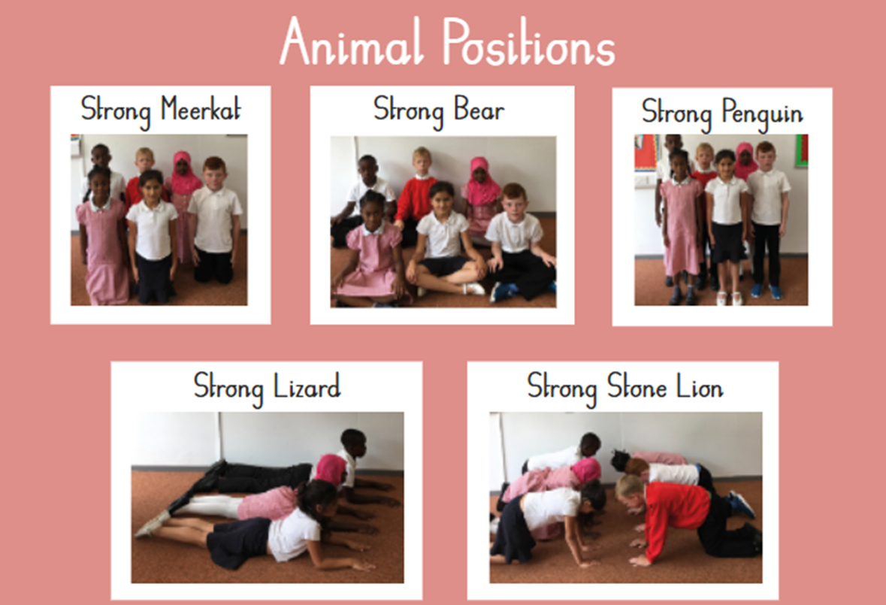

Slide 9
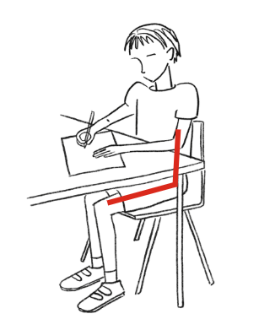
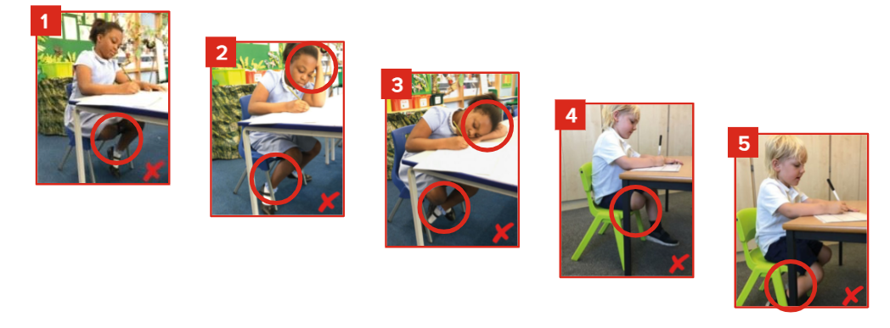
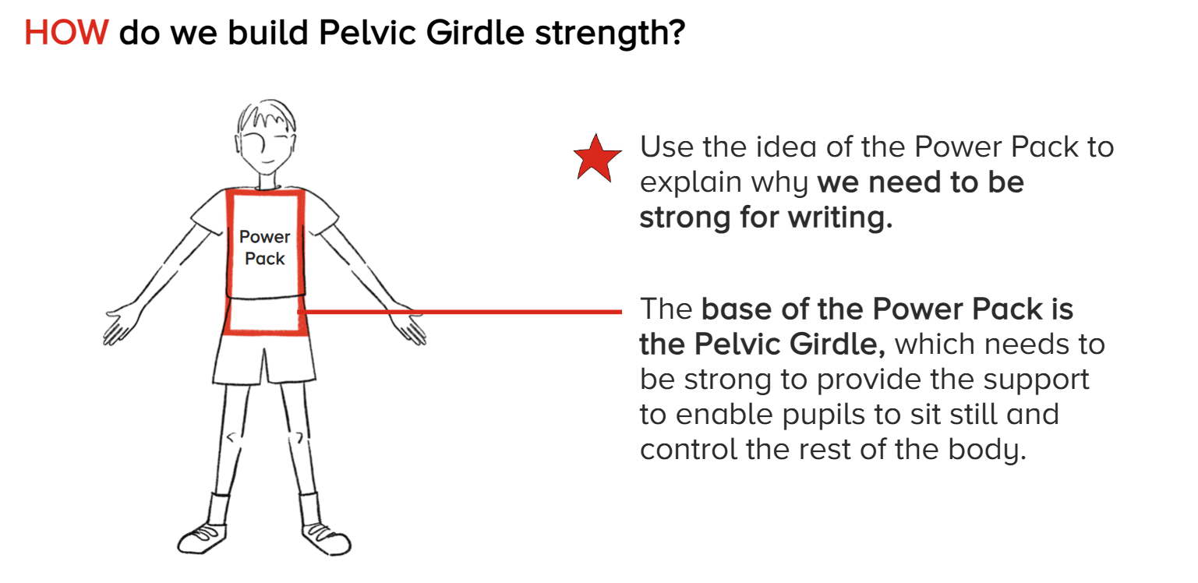
Power packs

Slide 10
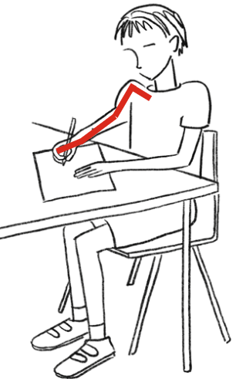
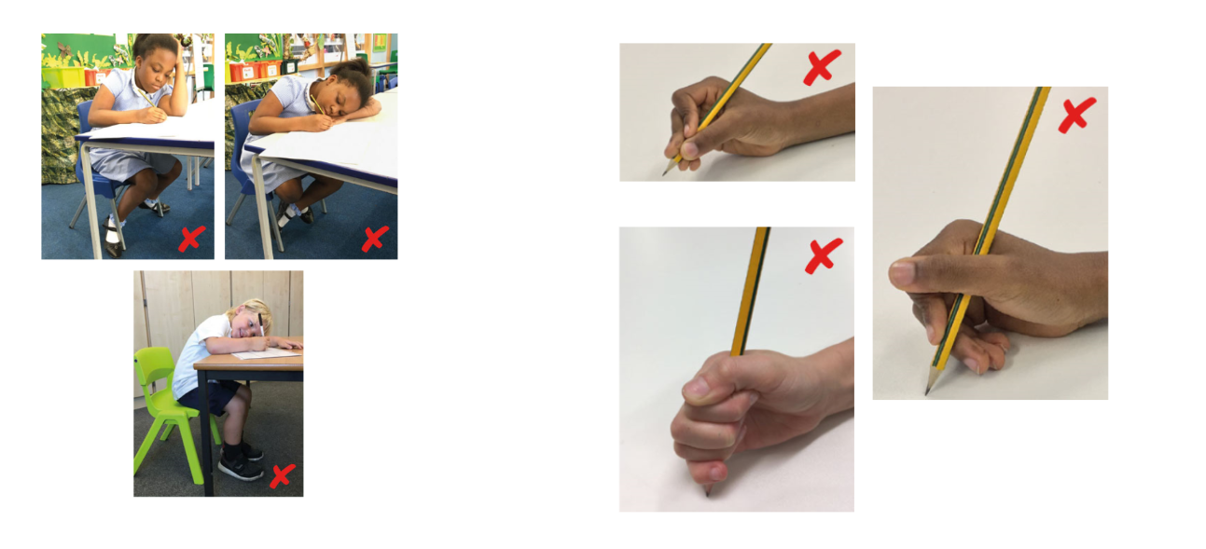
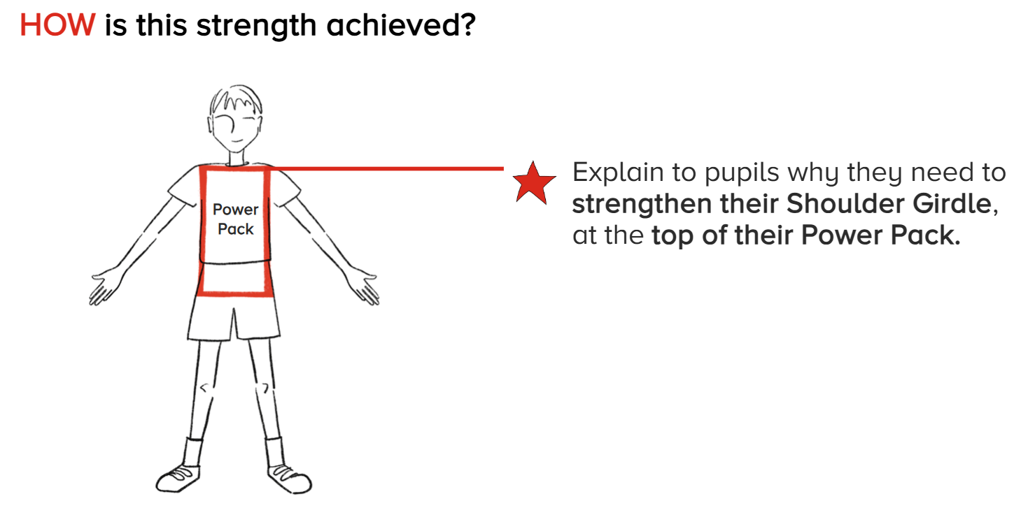
Shoulder Girdle Strength

Slide 11
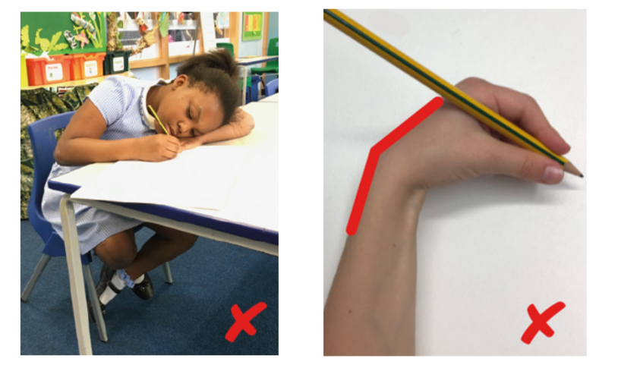
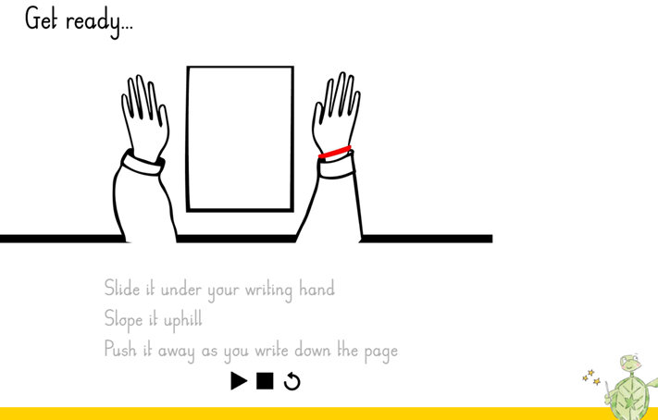
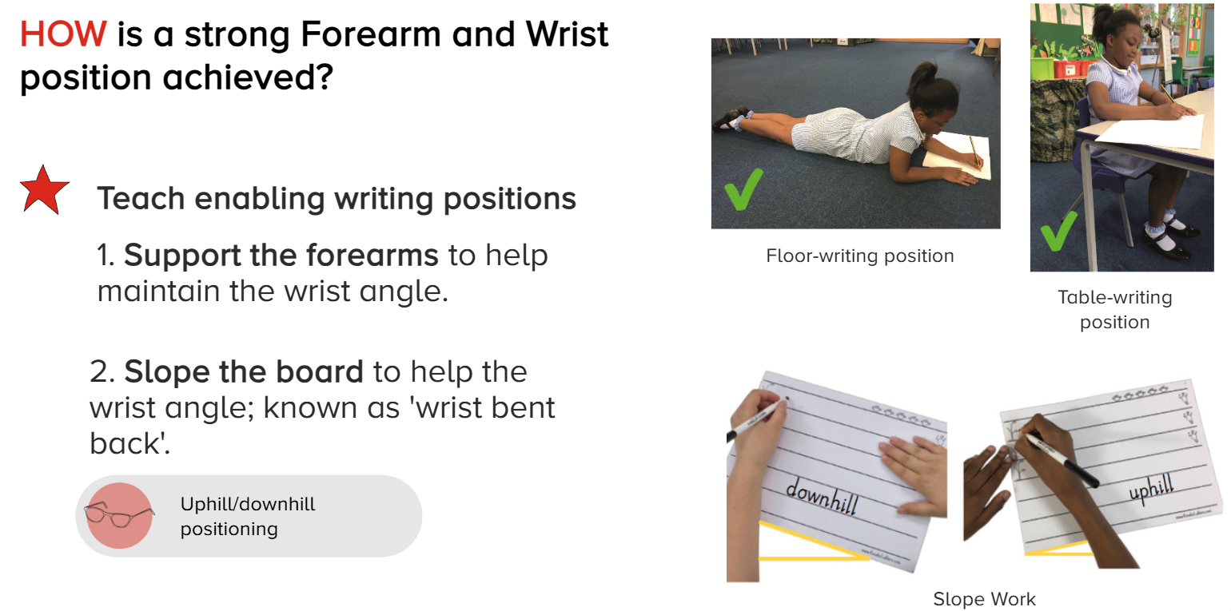
Forearm and Wrist Strength 3.4

Slide 12
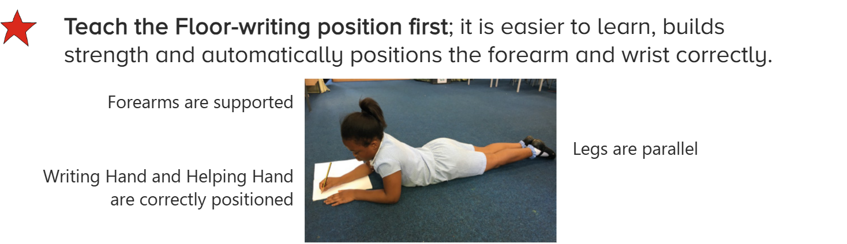
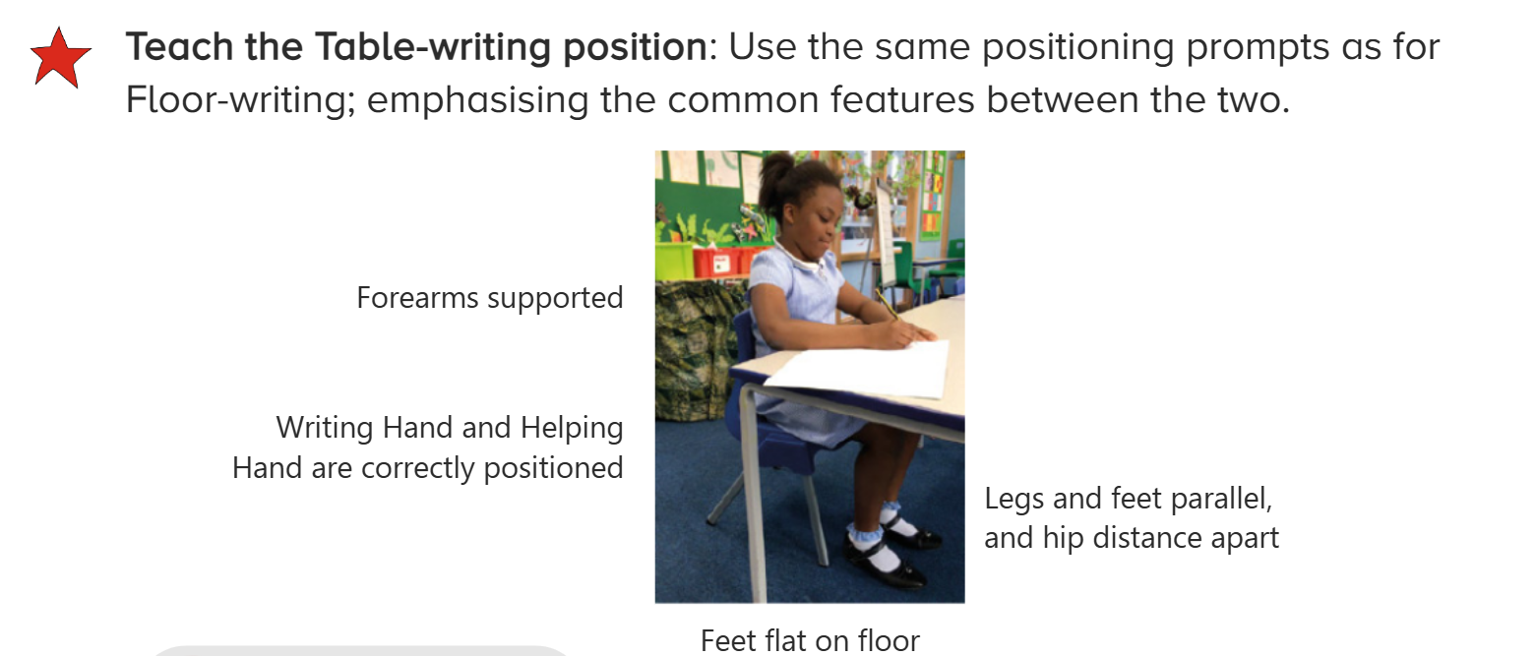
Writing Positions

Slide 13
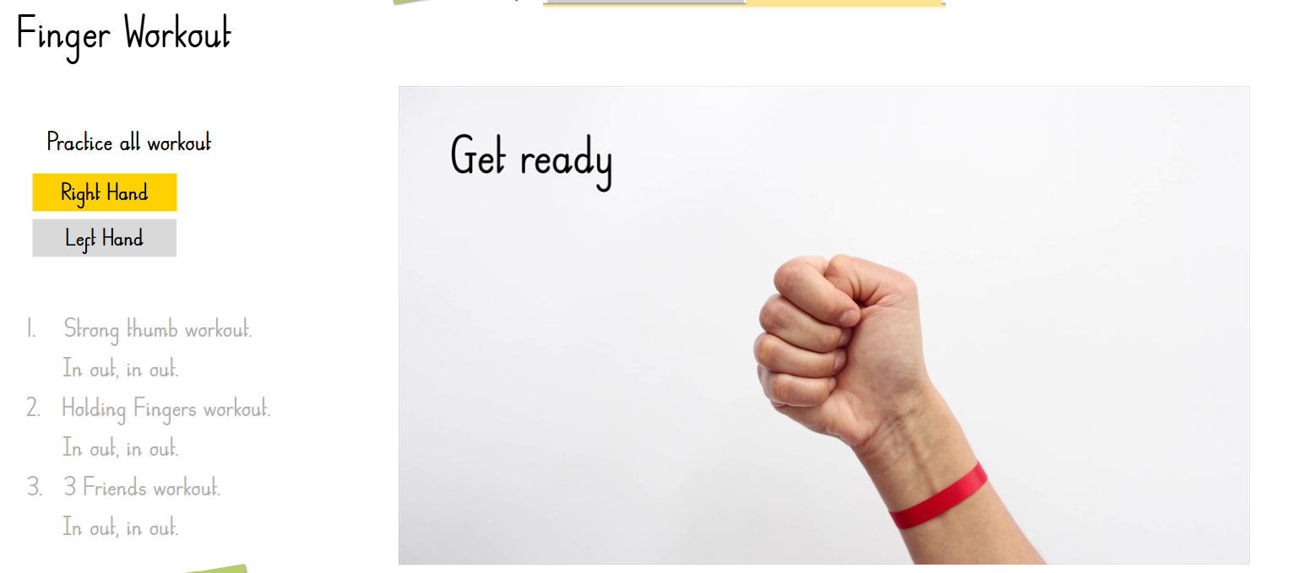
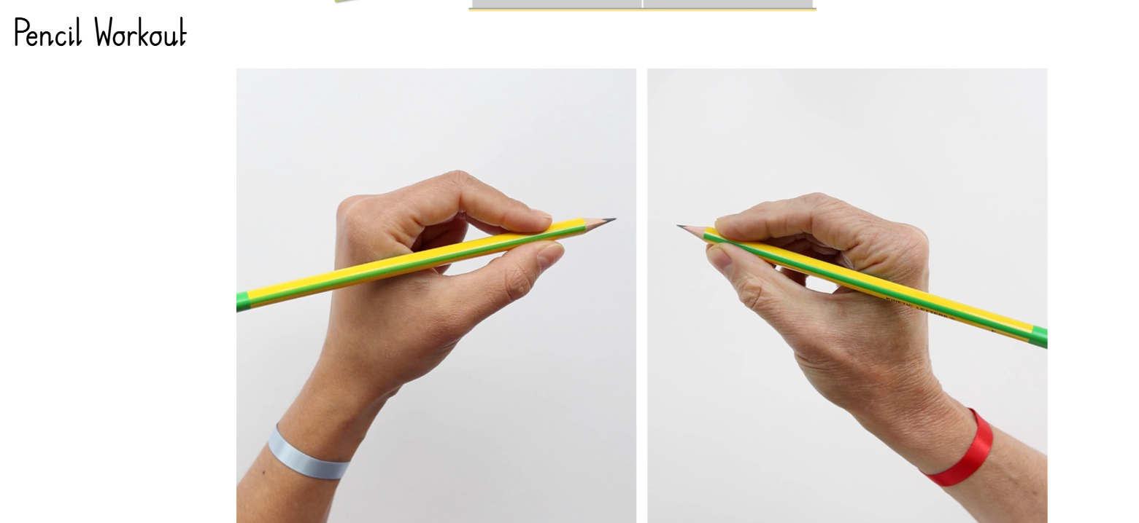
Hand and finger strength

Slide 14
Green Thread: Holding the Pencil

Slide 15
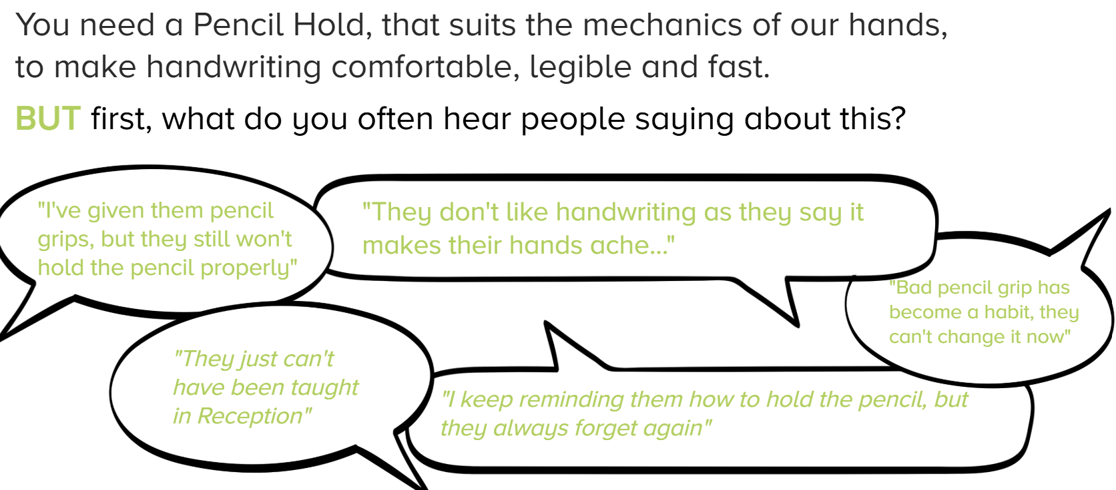

Slide 16
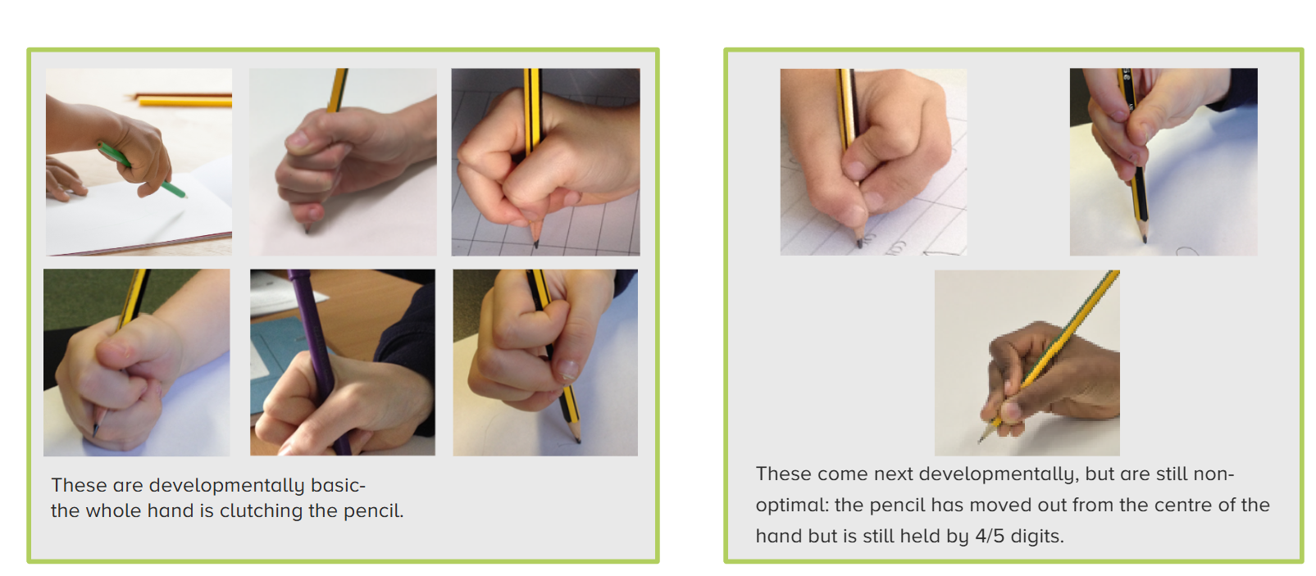

Slide 17
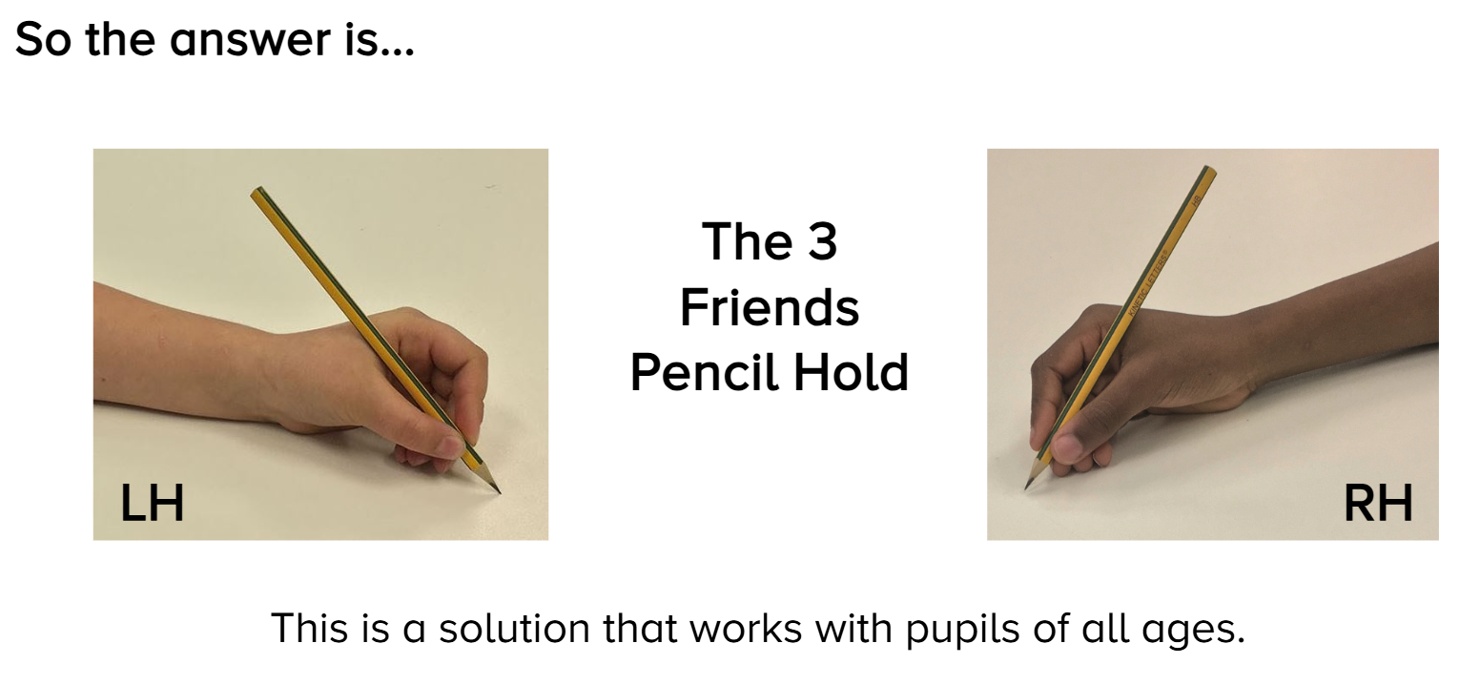

Slide 18
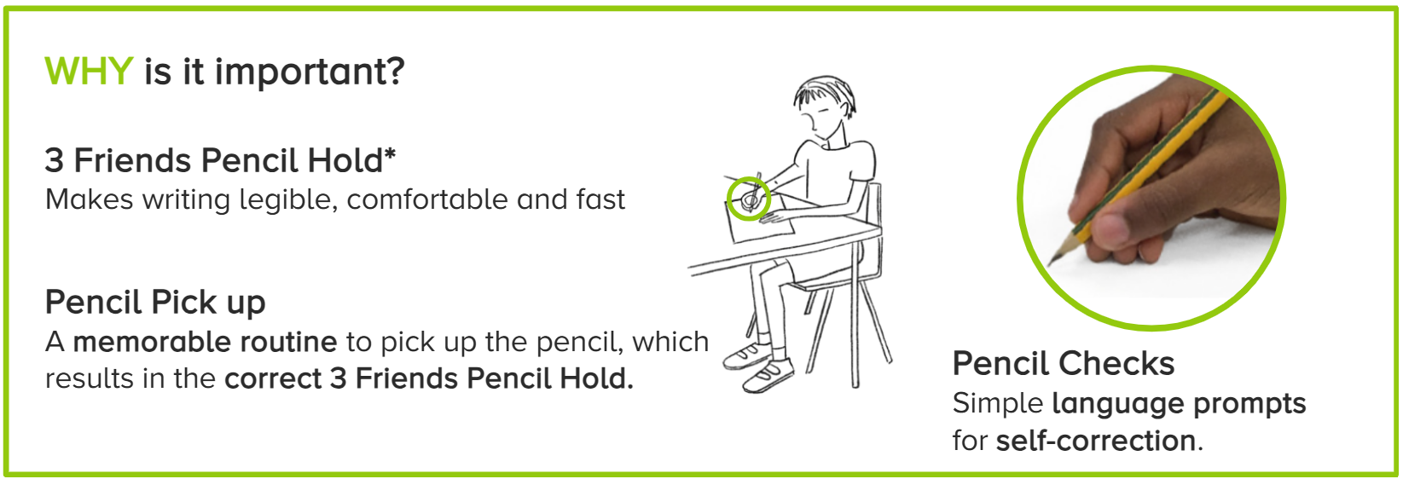
Pencil Pick Up and Checks

Slide 19
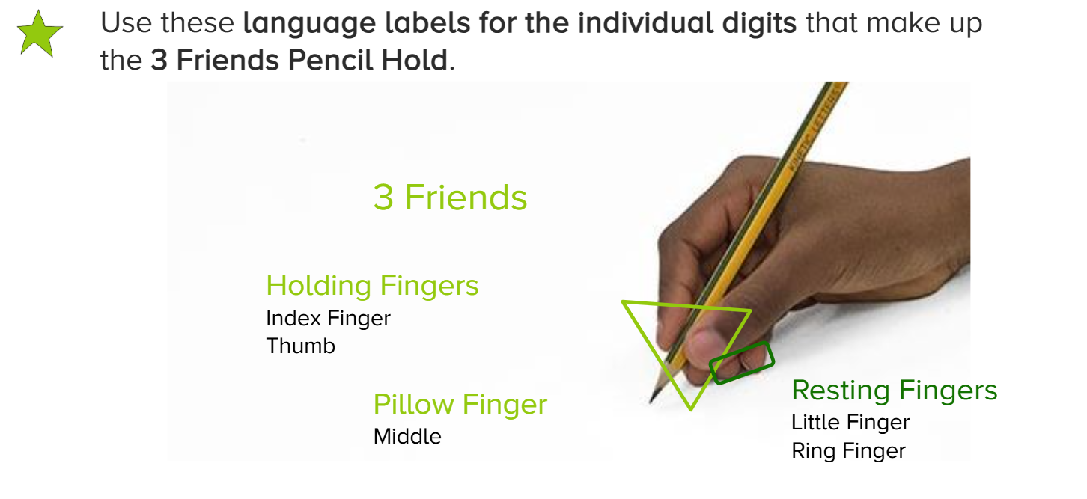

Slide 20
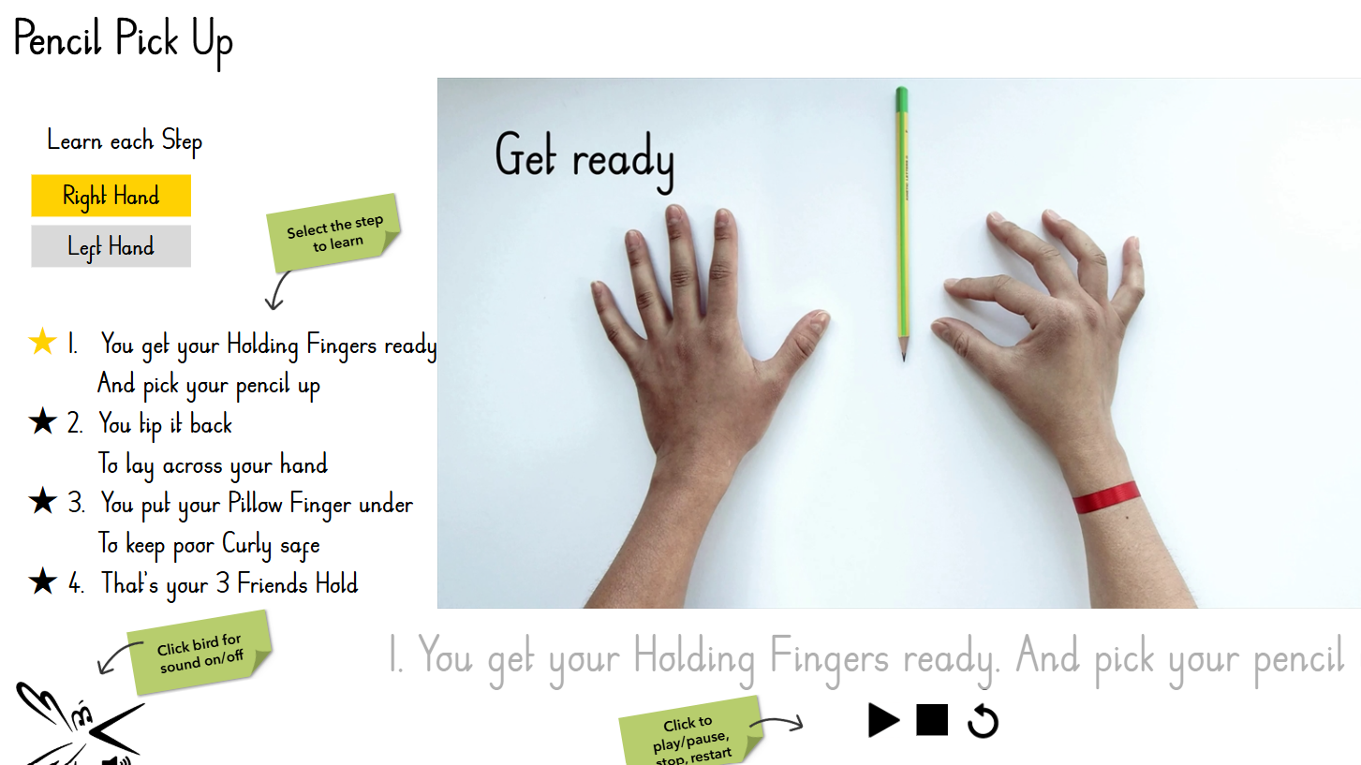
DDT 5 Pencil Pick Up

Slide 21
Yellow Thread: Learning the Letters

Slide 22
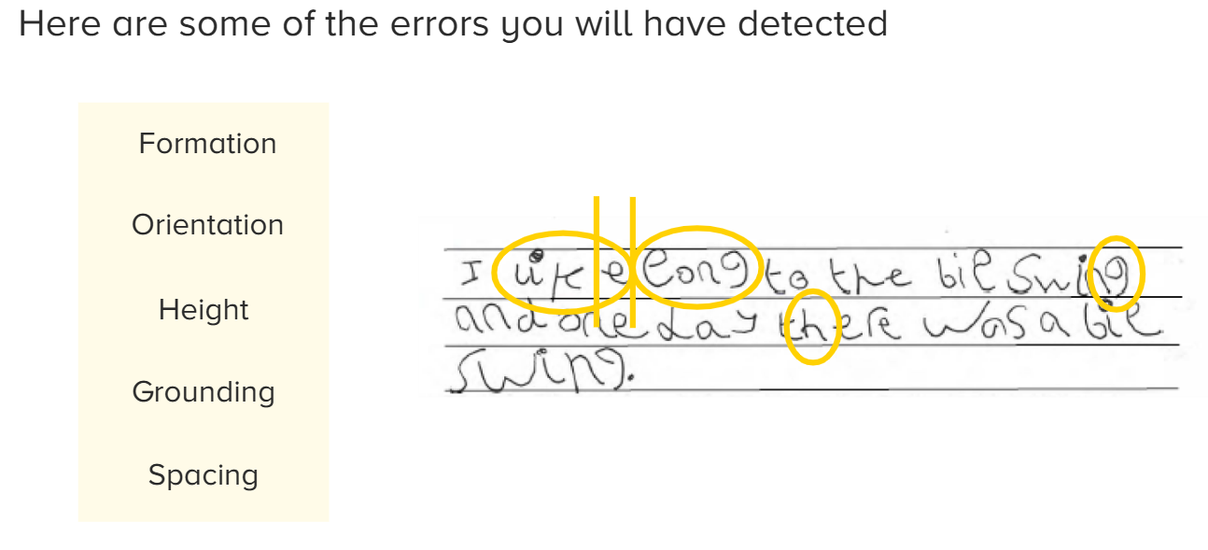

Slide 23
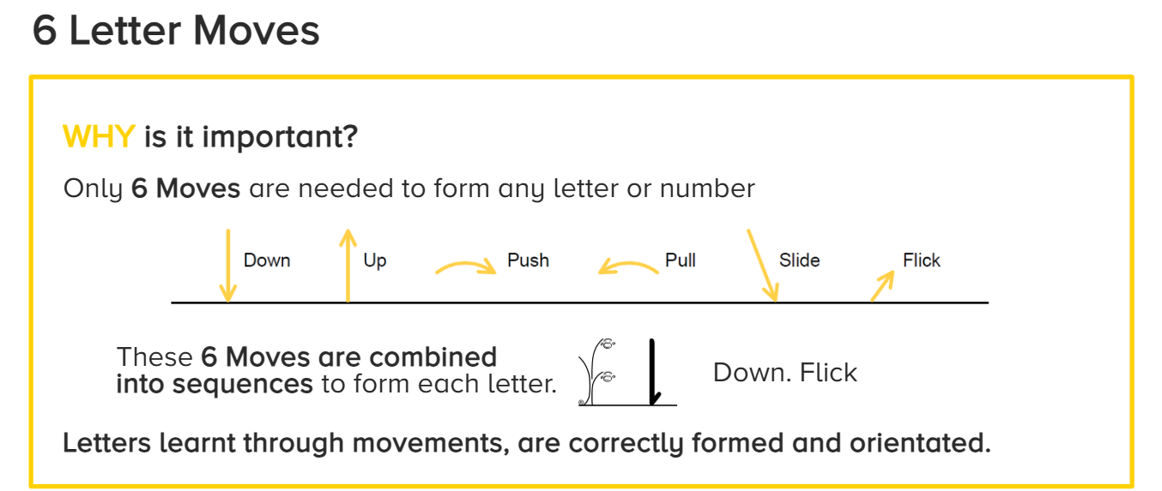

Slide 24
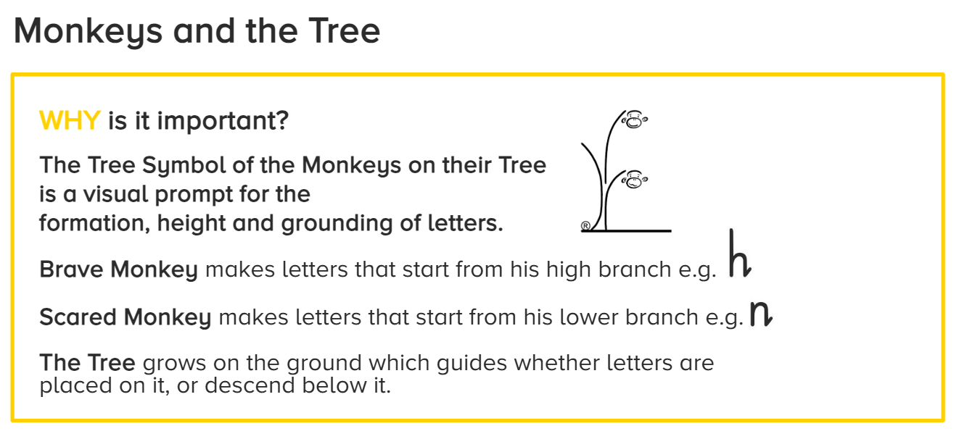

Slide 25
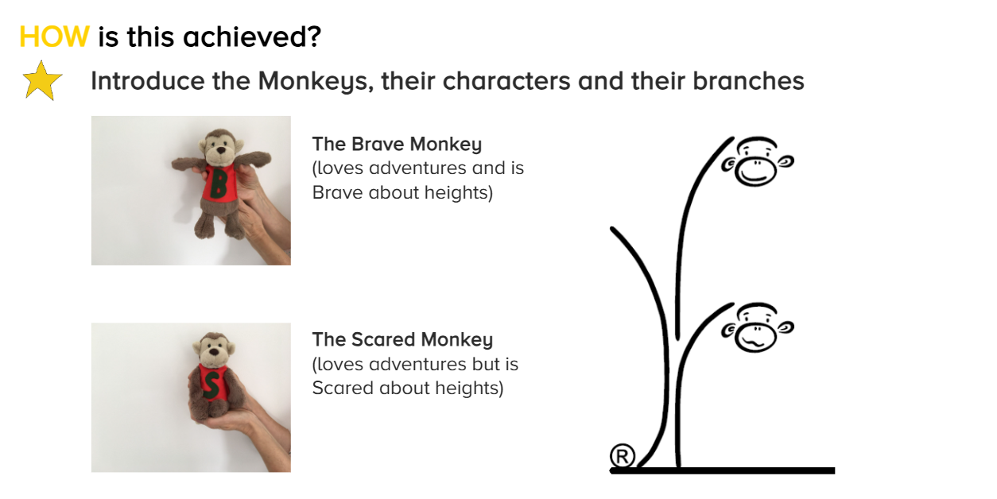
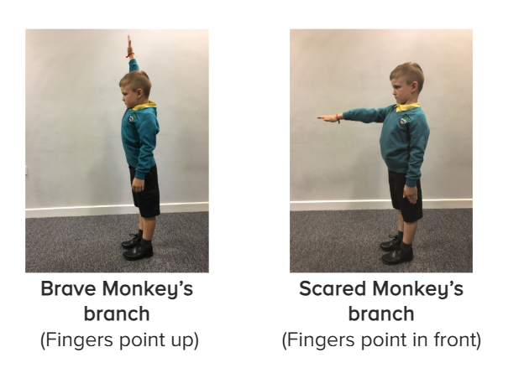

Slide 26
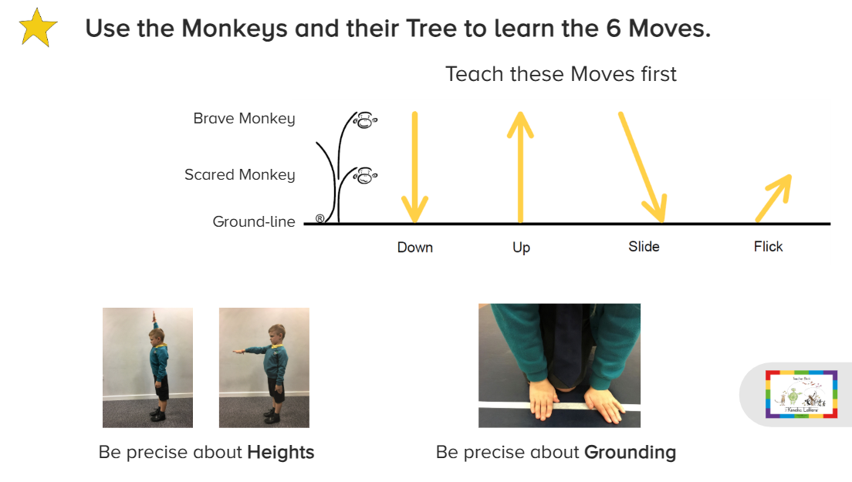

Slide 27
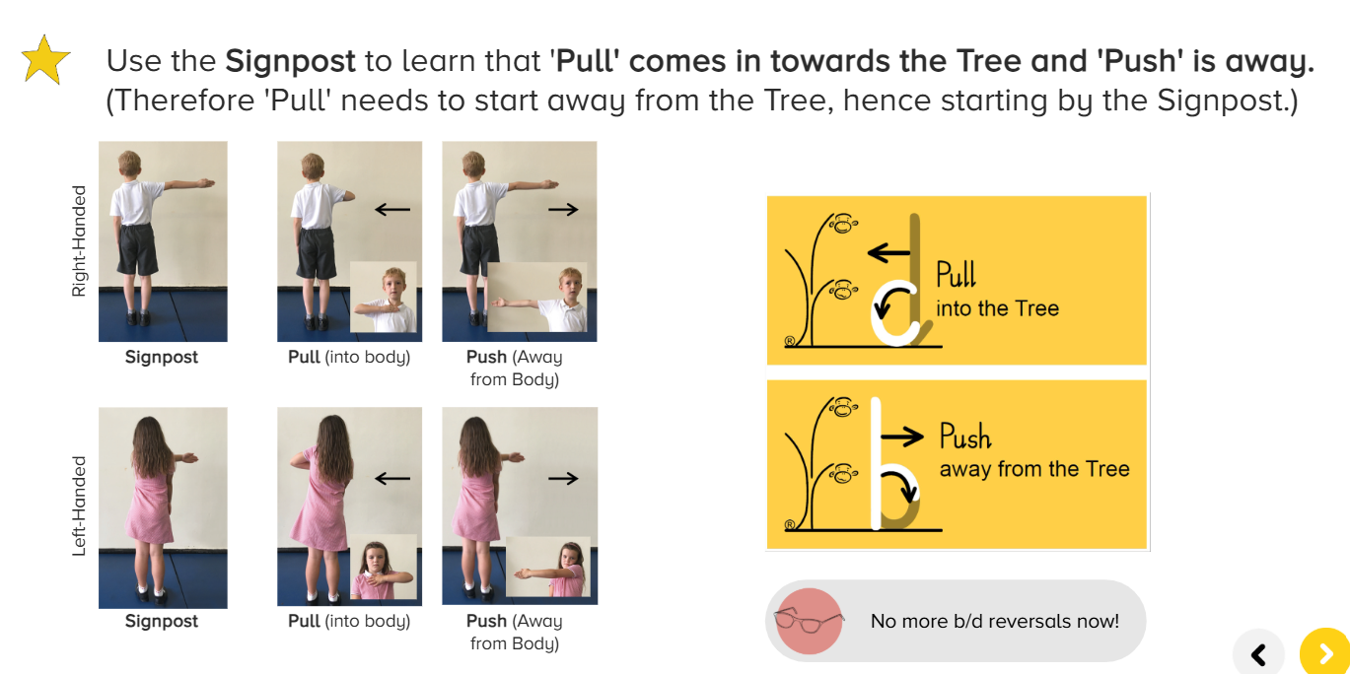

Slide 28
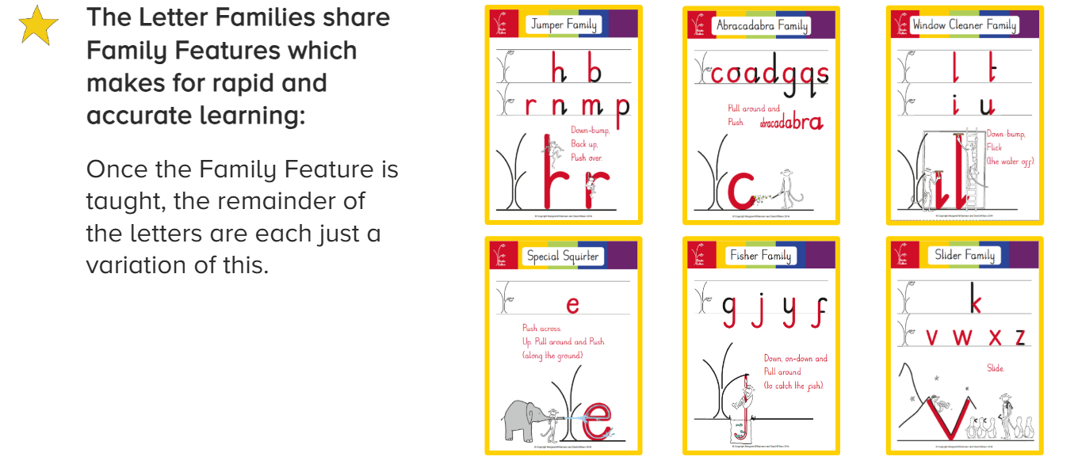
The Letter Families share Family Features which makes for rapid accurate learning:
Once the Family Feature is taught, the remainder of the letters are each just a variation of this.

Slide 29
Blue Thread: Flow & Fluency & The Joining Programme

Slide 30
Blue Thread: Flow & Fluency & The Joining Programme
Children understand they practise Flow to make writing easy and fast enough to write down all their ideas.
Staff teach children to feel Flow by writing in Air, then Sand and then on Whiteboards, writing ‘3 by the Tree’ along the line

Slide 31
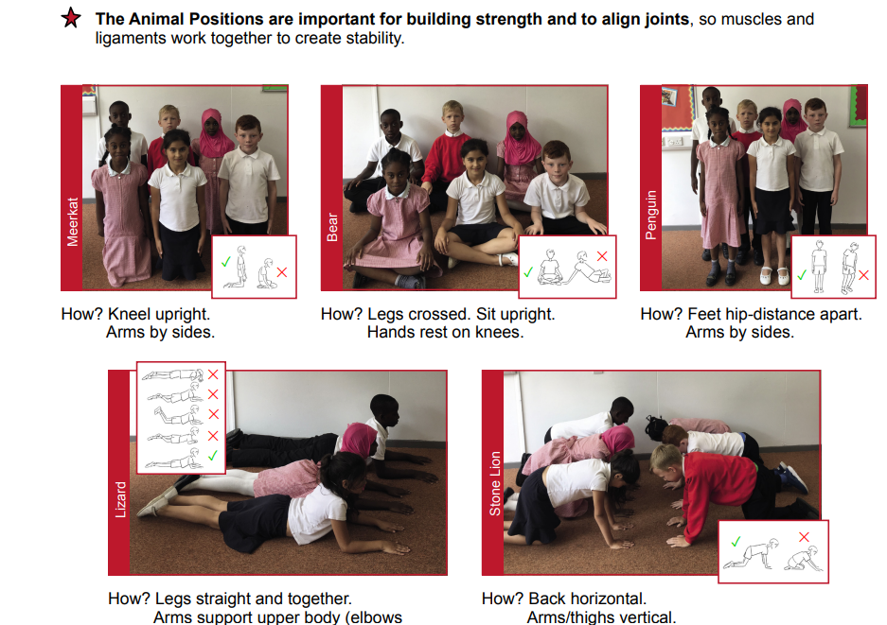
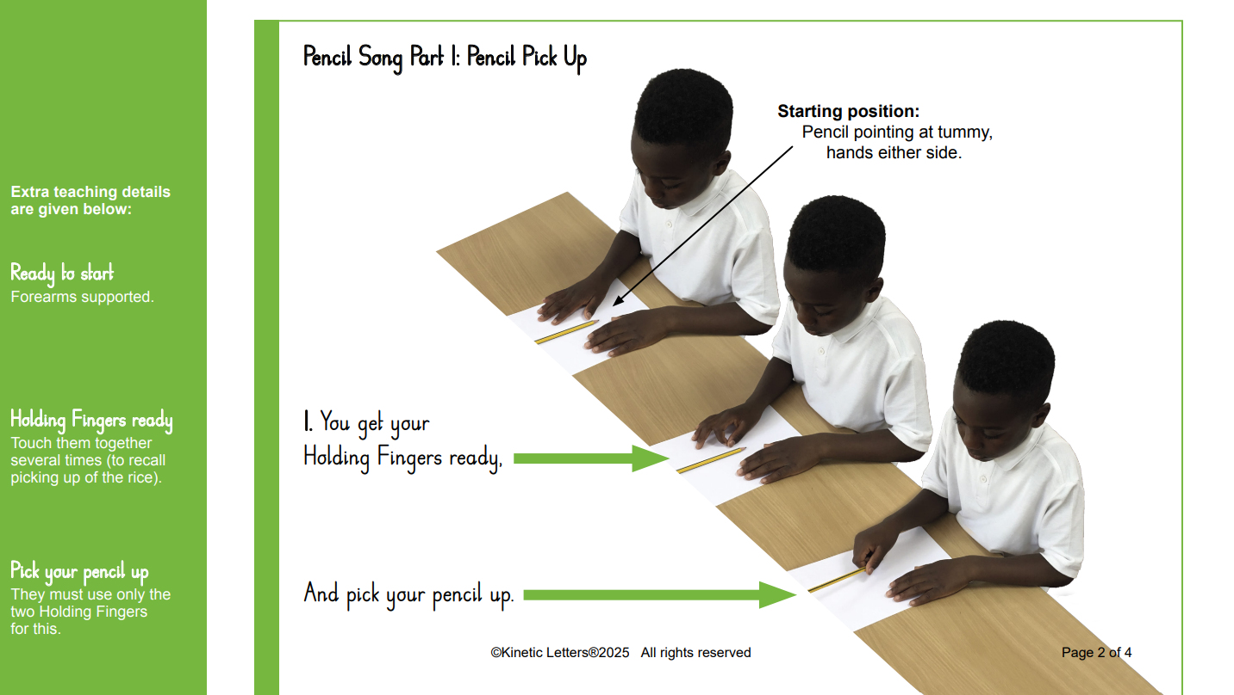
How to help at home:
Animal positions
Pencil Pick Up

Slide 32
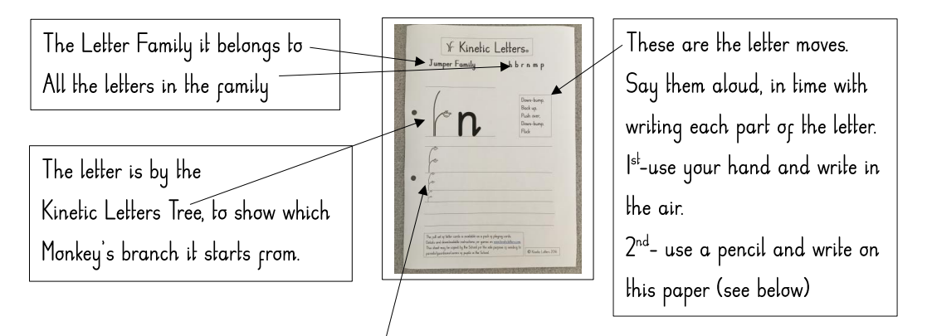
How to help at home:

Slide 33
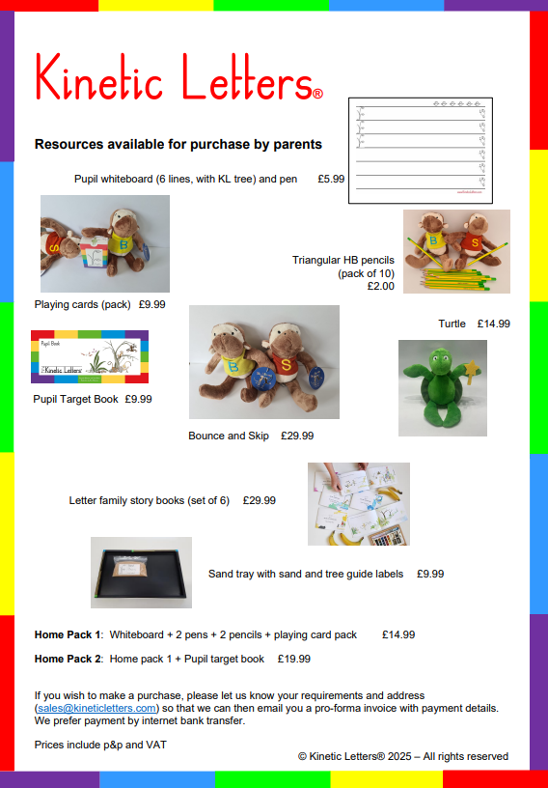
How to help at home:

